Slide 1
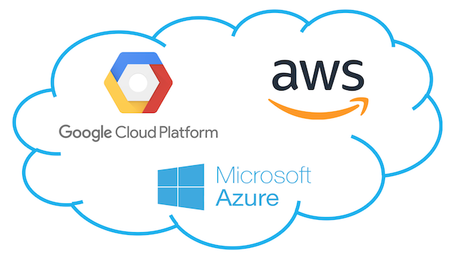
Cloud Platform Services

Slide 2
Contents
Amazon Web Services (AWS)
Google AppEngine
Microsoft Azure

Slide 3
AWS
Services Offered by the AWS ecosystem.
Compute Services
Storage Services
Communication Services
URL:
Introduction to AWS Services: https://www.youtube.com/watch?v=Z3SYDTMP3ME

Slide 4
Compute Services
AMI
EC2 Instances
EC2 Environment
Advanced compute services
AWS Elastic beanstalk- https://www.youtube.com/watch?v=SrwxAScdyT0#action=share
AWS Cloud Formation-https://www.youtube.com/watch?v=Omppm_YUG2g&feature=youtu.be
Amazon Elastic MapReduce - https://www.youtube.com/watch?v=QuwaBOESGiU#action=share

Slide 5
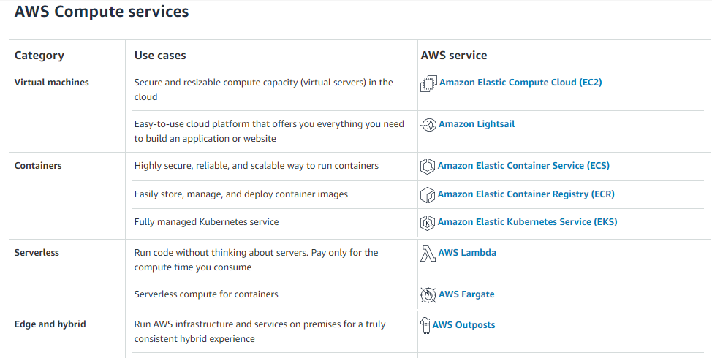

Slide 6
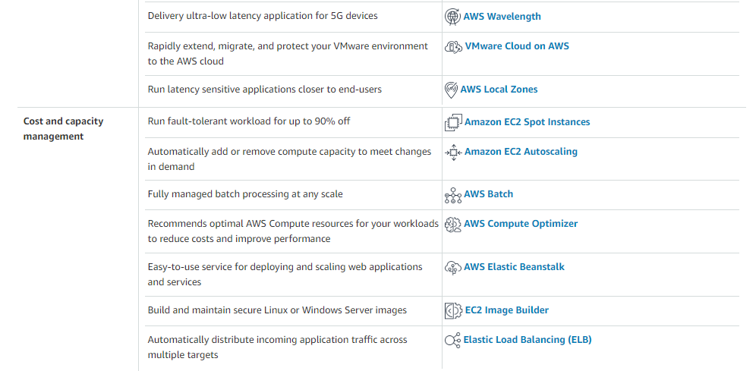

Slide 7
Storage Services- https://aws.amazon.com/products/storage/
S3 Key Concepts: https://www.youtube.com/watch?v=77lMCiiMilo
Resources Naming
Buckets
Objects and metadata
Access Control and Security
Amazon Elastic Block Store- https://www.youtube.com/watch?v=77qLAl-lRpo#action=share
Amazon ElastiCache
Structured Storage Solution
Amazon RDS - https://www.youtube.com/watch?v=eMzCI7S1P9M#action=share,
Amazon SimpleDB- https://www.youtube.com/watch?v=4wMB5qQvA8c
Amazon CloudFront

Slide 8
Communication Services
Virtual Networking
Messaging
Additional Services

Slide 9
Google AppEngine
Architecture and core concepts https://www.youtube.com/watch?v=s1g4H4-MSJg
Infrastructure
Runtime environment- Sanboxing, Supported runtimes
Storage- Static file servers, Data store
Application Services- UrlFetch, MemCache, Mail and instant messaging. Account management, Image manipulations
Compute services- Task Queues,Cron Jobs; https://cloud.google.com/compute
Application life cycle- App development and management, cost model & Observations;
To view products: https://cloud.google.com/products

Slide 10
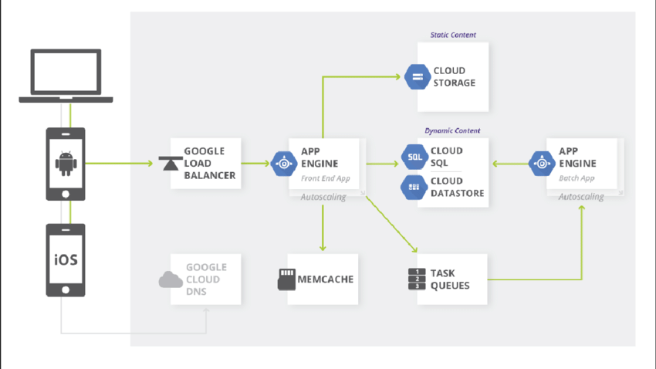

Slide 11
Microsoft Azure
Azure core concepts
Compute services- web role, worker role, Virtual machine role https://azure.microsoft.com/en-in/product-categories/compute/
Storage services- Blobs, Azure drive, tables, queues
Core infrastructure: AppFabric- Access Control, Service bus, Azure cache
Other Services
SQL Azure
Windows Azure Platform & Observations
Azure Fundamentals: https://www.youtube.com/watch?v=M7v52Wbe8Dc&list=PL-V4YVm6AmwWLTTwZdI7hcpKqTpFUIKUE

